Slide 1
Big Data, AI, Machine Learning, Investment and Algo Trading
Ken Liu

Slide 2
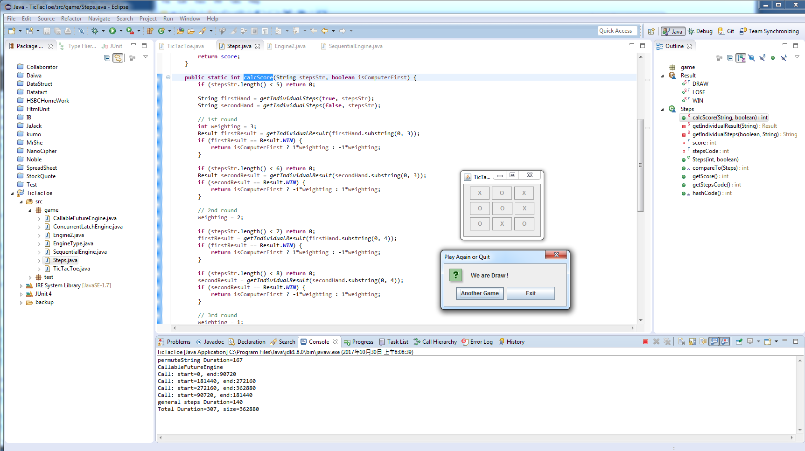

Introduction to AI - First AI Boom
Tick Tac Toe Example

Slide 3
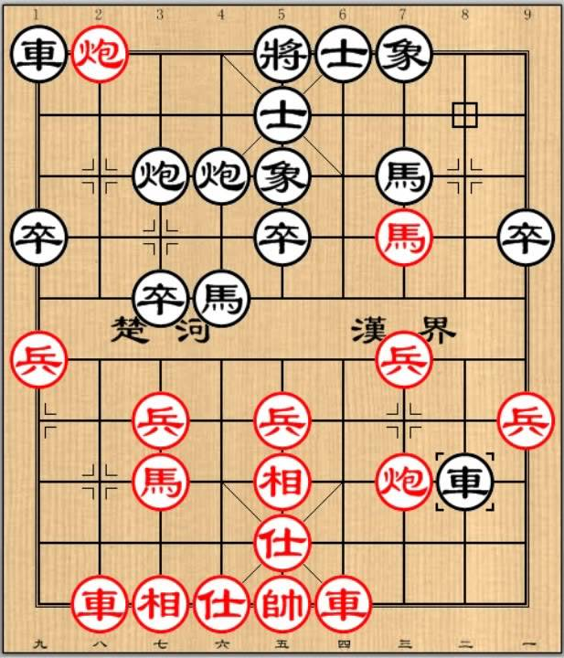
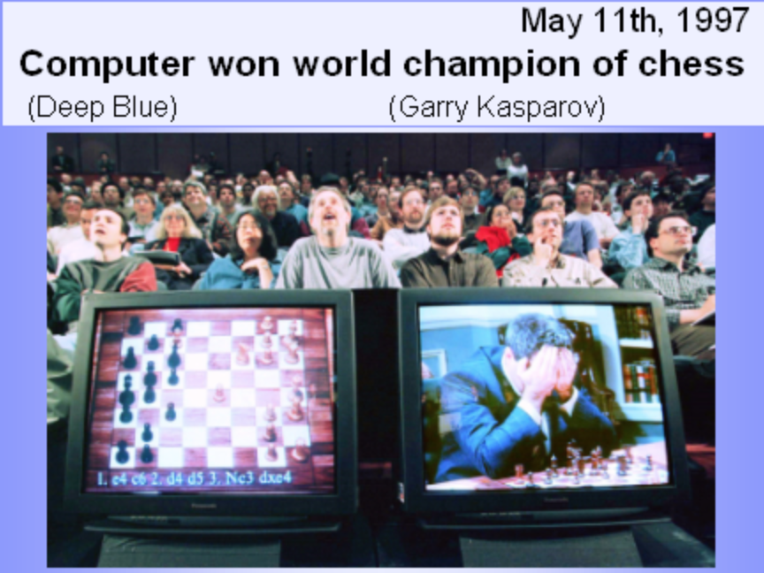

Introduction to AI - First AI Boom
Do I need to be a good chess player to write a good chess game?

Slide 4
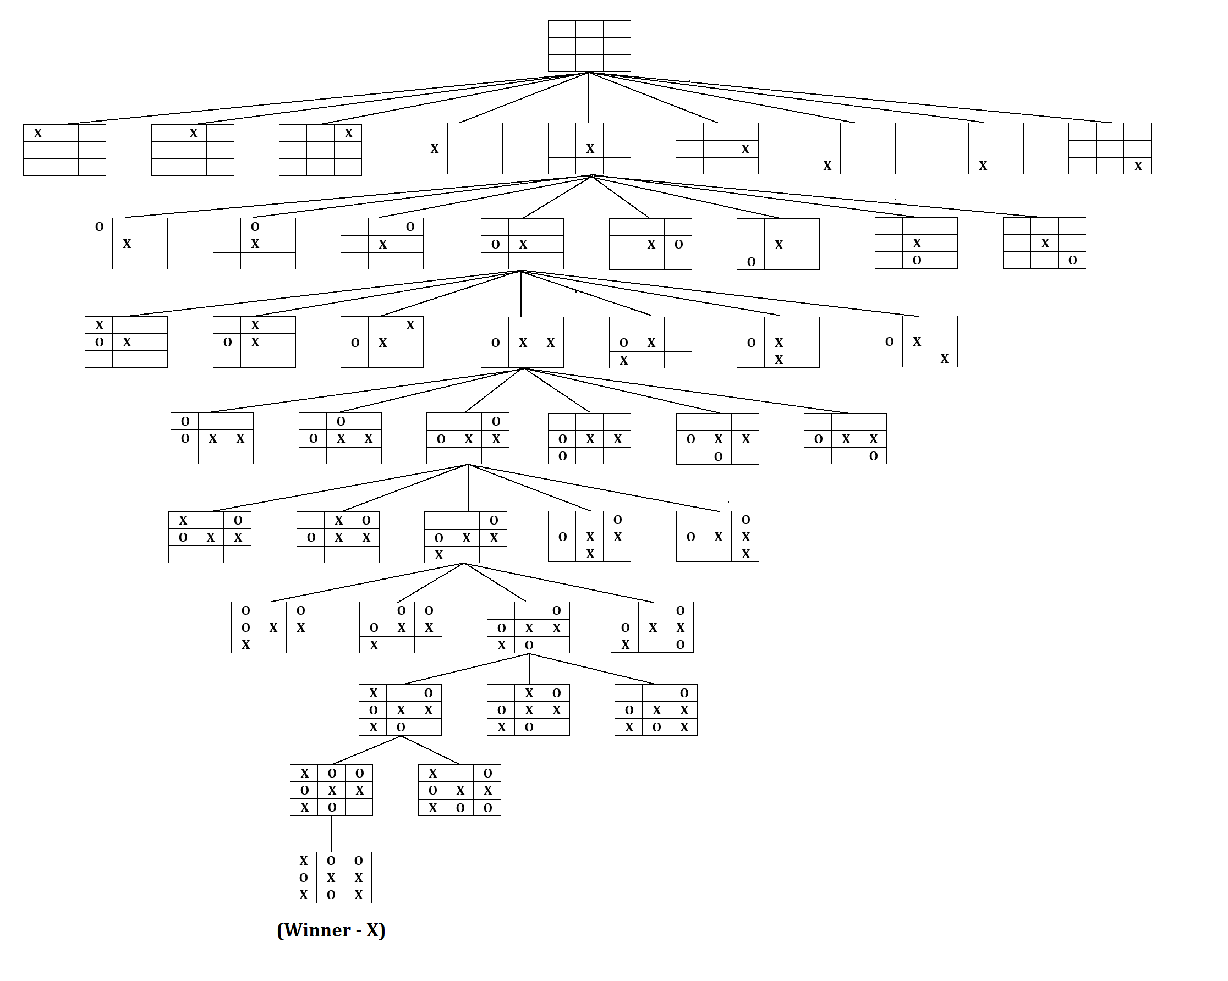
Introduction to AI - First AI Boom
No need. Computer just evaluate the game tree. Advanced Level means evaluating more level at each steps. Moreover, towards the end game, computer becomes faster (as fewer steps to evaluate) while human players tends to spend more time to think of each of steps carefully.
Game Search Tree

Slide 5
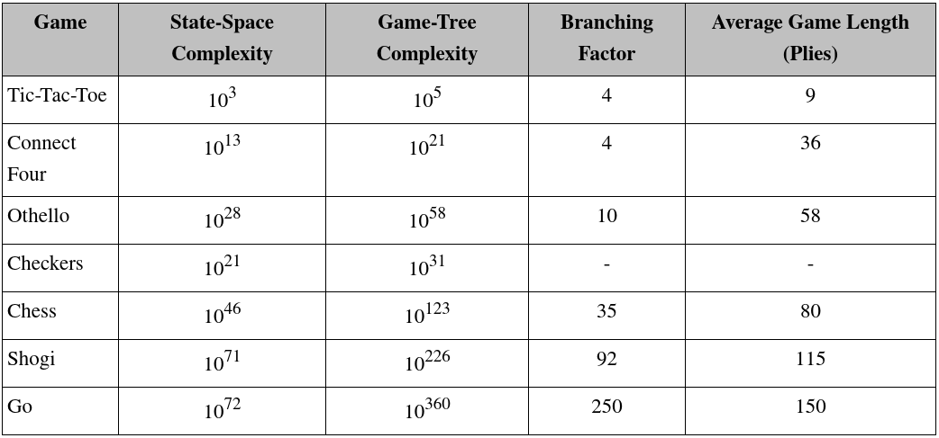
Introduction to AI - First AI Boom
Key Points: State-Space (Complete Information and deterministic), Search Tree (Brute-force, Heuristic, Adversarial), Goal (Score, Weighting)

Slide 6
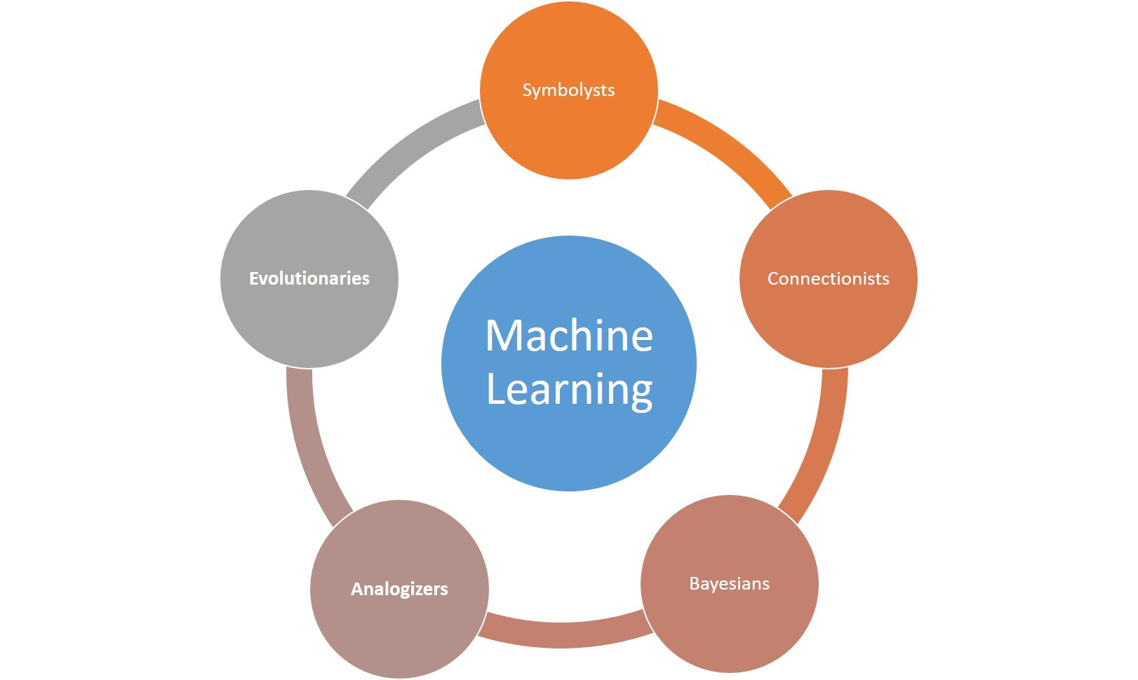
Introduction to AI – Approaches

Slide 7
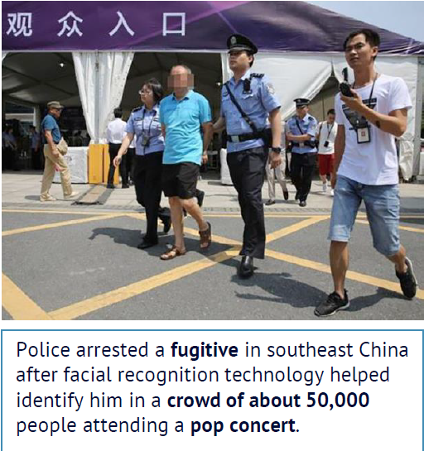
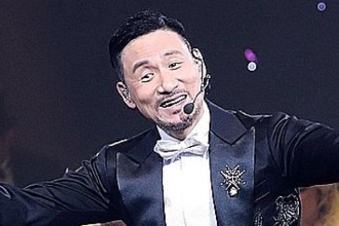
Introduction to AI - Third AI Boom (Now)
Machine Learning: a branch of AI and the key driver is (big) data from Internet, Mobile and IoT (Internet of Things which are sensors, smart devices etc.)
Example: 1.3 billions of faces in China, how can tell a computer to recognize a person?
# pseudo code
Color in {brown, yellow, black}
Has {hair, eye * 2, nose, mouth,
ear * 2 ……}
Eye: {black, white, brown ……..}
……………….
https://www.npr.org/sections/therecord/2018/05/23/613692526/thanks-to-ai-a-3rd-person-is-arrested-following-a-pop-superstars-concert

Slide 8
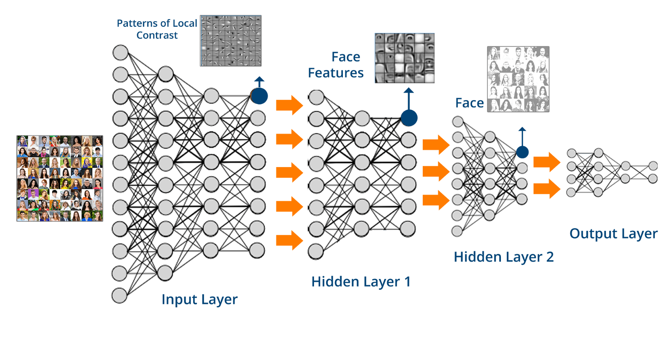
Machine Learning - Data
Learn from data rather than explicitly program the logic: let the computer see many examples (face, name) and learn how to represent it in a Deep Neural Network (brain-like structure)

Slide 9
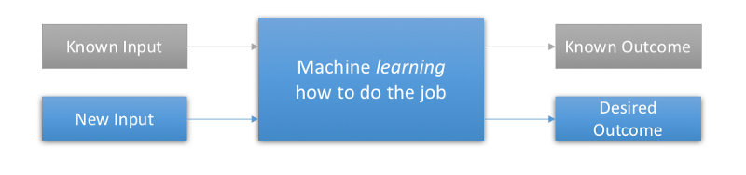
Machine Learning – Labelled Data
Supervised Learning: presented with example inputs and their desired outputs (labelled dataset), given by a "teacher“.
The goal is to learn a general rule that maps inputs to outputs (i.e. learn a function of y = x)

Slide 10

Machine Learning – Labelled Data
Where to find labelled dataset?
Freely source from the web
Kaggle Dataset
Google Dataset Search
AWS Open Data
Pay $
Human Data Labeler
Amazon Mechanical Turk
Datafarm.co ← (My friend’s startup)

Slide 11
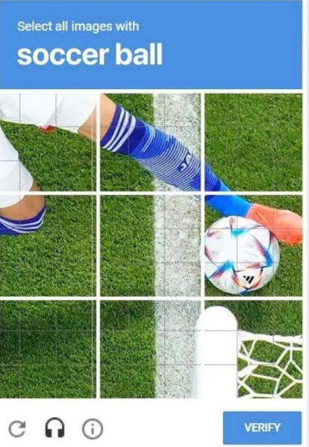
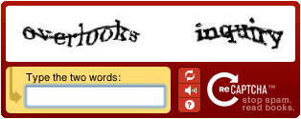
Machine Learning – Labelled Data
Where to find more labelled dataset freely?
From YOU!
Google reCAPTCHA

Slide 12
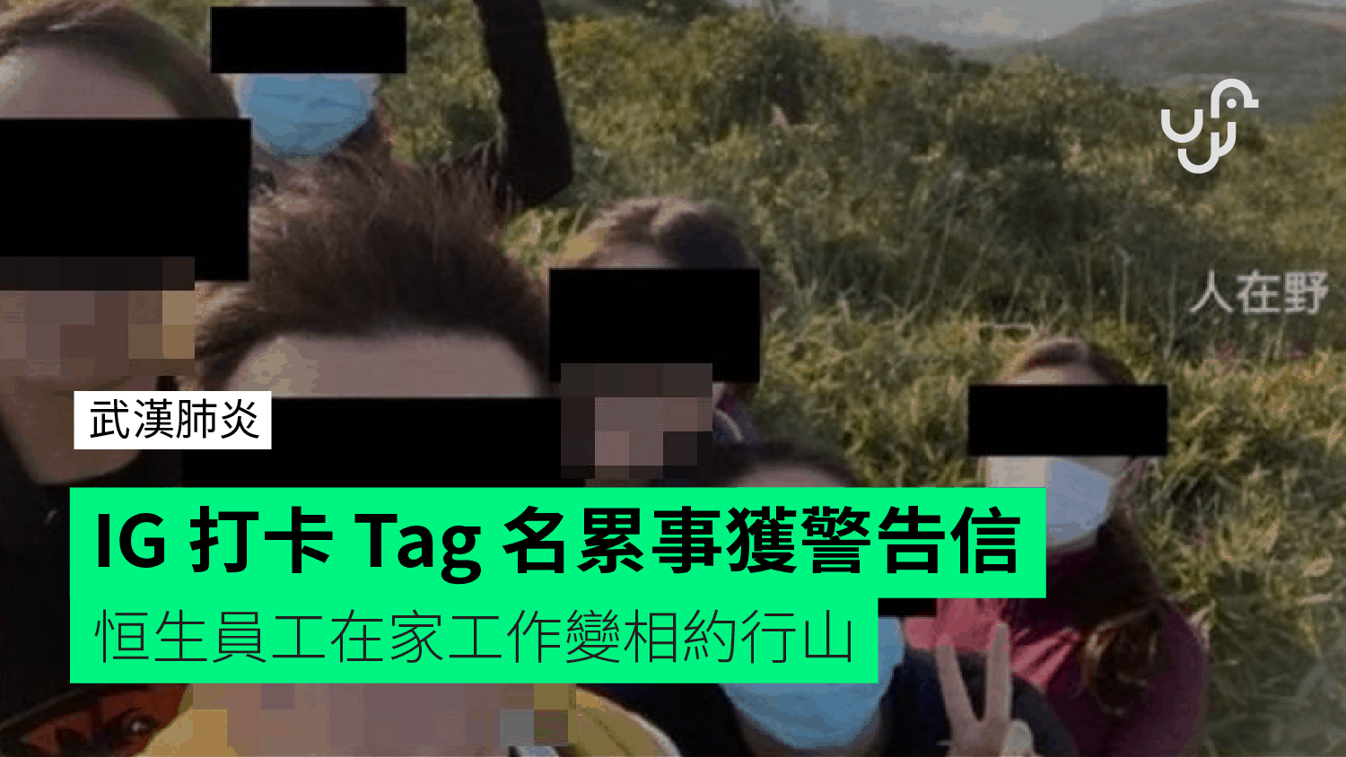
Machine Learning – Labelled Data
WFH (Work from Home Hill)
Tagged your friends in Facebook or IG
若要人不知,唔好玩IG
Don’t post in IG and keep it privately

Slide 13
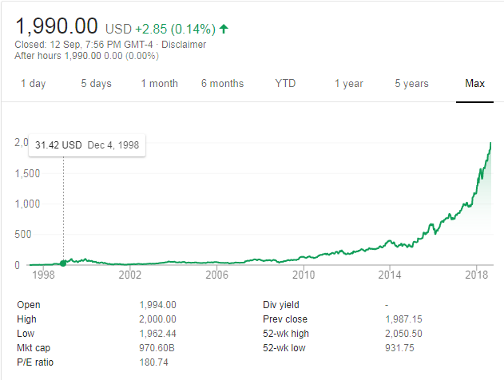

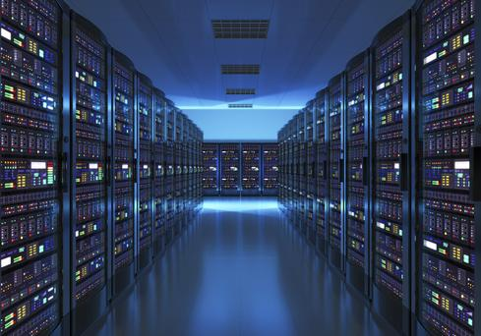
Machine Learning - Cloud
Commodities Infra (Cloud) : rent super computers (from AWS, Google Cloud etc.) for few hours to train the machine learning model. (Training vs Predicting time)
Notes:
Long nVidia is better than so many quant trades !

Slide 14
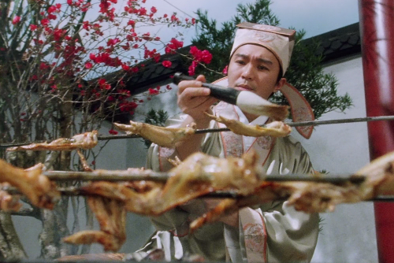
Machine Learning - GPU
IQ Test: Cook 1 chicken wing requires 10 mins. How many minutes for cooking 10 chicken wings?
Still 10 mins - cook chicken wings in parallel because each chicken wing is independent of each others
Compare to bank transactions which has to perform step-by-step
Supervised training is similar to cooking chicken wings as many labelled data in the dataset (e.g. face and name) is independent to each others
Notes:
Long nVidia is better than so many quant trades !

Slide 15
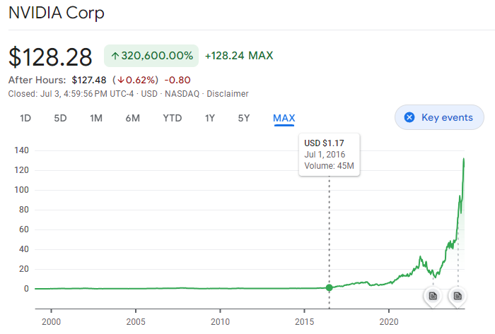
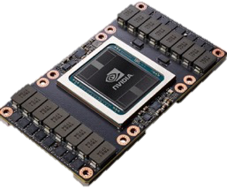

Machine Learning - GPU
Hardware Parallelization: GPU (Graphics Processing Unit) substantially improve the speed of calculation (nVidia stock price has gone up substantially)
AI, Deep Learning, Crypto Mining, GenAI
Tesla V100 : 120 TFLOPS
Notes:
Long nVidia is better than so many quant trades !

Slide 16
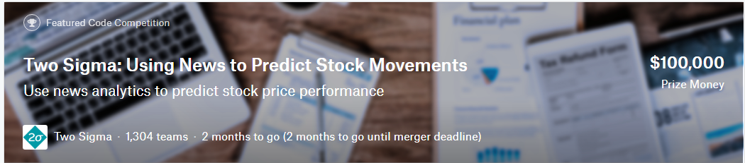
Machine Learning - Community
Kaggle Competitions: Two Sigma: Using News to Predict Stock Movements
The challenge is ingesting and interpreting the data to determine which data is useful, finding the signal in this sea of information. Two Sigma is passionate about this challenge and is excited to share it with the Kaggle community.
By analyzing news data to predict stock prices, Kagglers have a unique opportunity to advance the state of research in understanding the predictive power of the news. This power, if harnessed, could help predict financial outcomes and generate significant economic impact all over the world.
Market data provided by Intrinio.
News data provided by Thomson Reuters

Slide 17
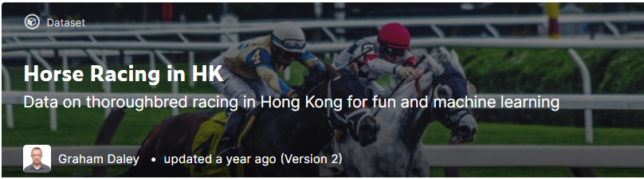
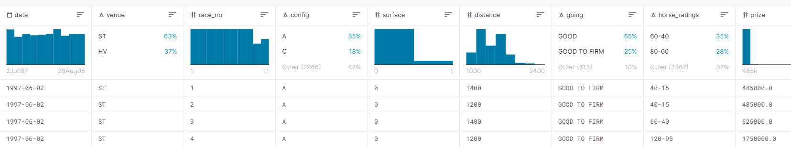
Machine Learning - Community
Kaggle Dataset

Slide 18
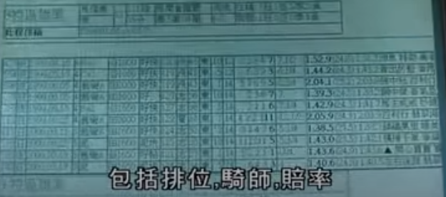
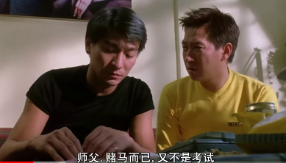
Machine Learning - Community
Hong Kong Jockey Club
Executive Manager, Artificial Intelligence (Sports Betting)
The main responsibility of the candidate is around fixed odds sports betting - to lead a skilled team of data analysts or scientist to applying cutting edge AI Machine learning and big data analysis to improve gross margin rate of Fixed Odds Sports Betting
Predicting Horse Racing Result by AI
Students: Clarence Ng, Keith Jones, Jason Lam, Richard Dela Cruz,Tree Chan

Slide 19
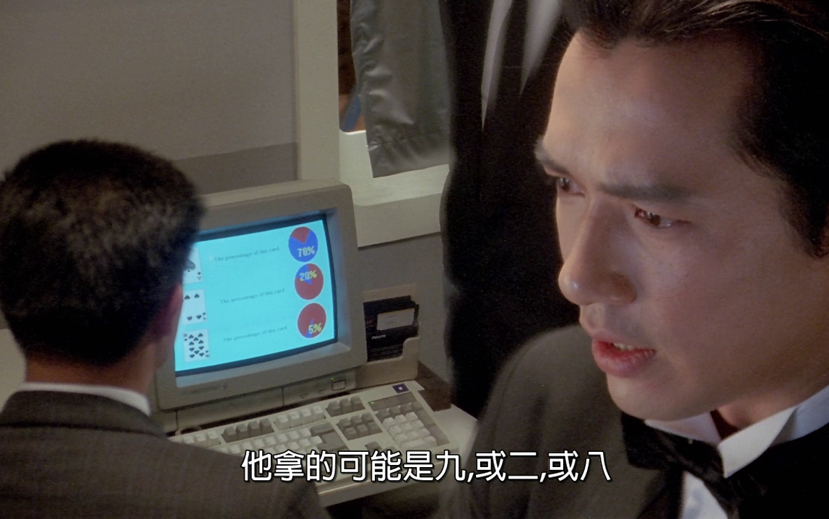
Demo – Short Term Stock Price Prediction
Objective: Predict the short term (next move) directional (up or down) stock (e.g. Tencent) price movement based on historical data
Solution: Use Supervised Machine Learning with labelled data to do classification (up or down)

Slide 20
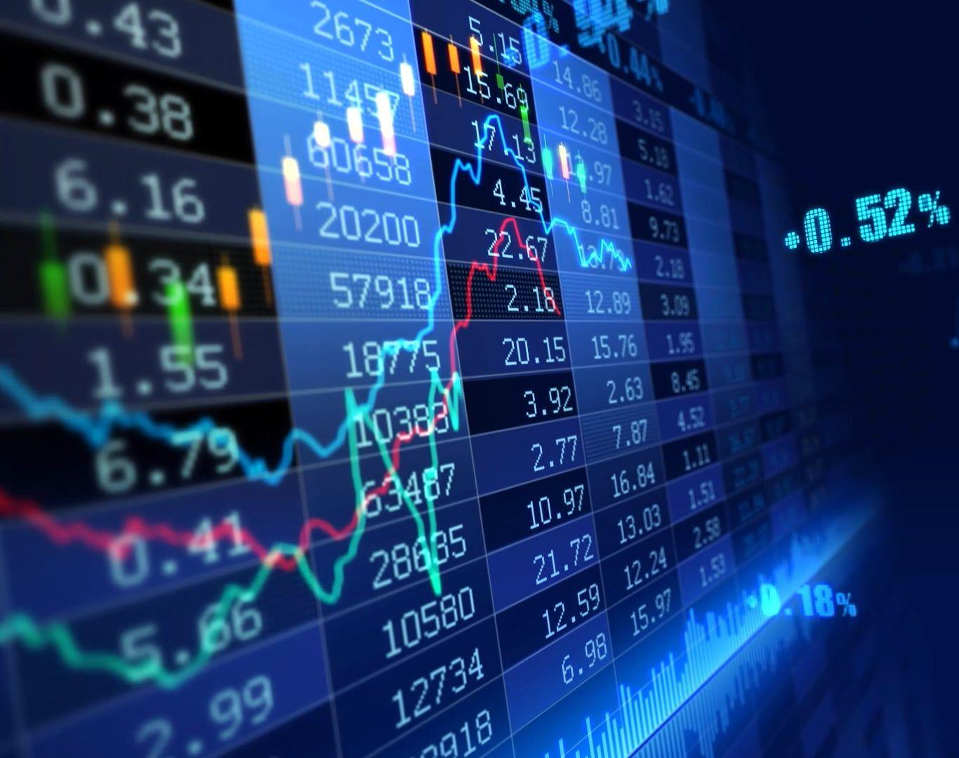
1. Raw Data – Historical Tick Data
Step 1: Get the raw source data
Free data from Yahoo Financial: the daily open/high/low/close/volume is not detail enough to predict the short term price movement
Need to purchase the very detail raw data (historical tick data) from the Hong Kong Stock Exchange

Slide 21
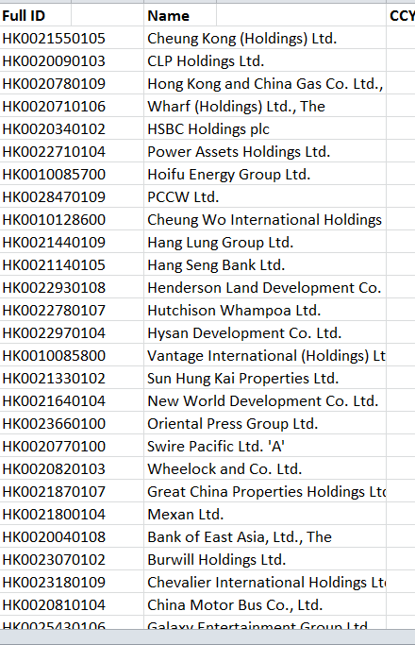
1. Raw Data – Historical Tick Data
https://www.hkex.com.hk/eng/ods/historicalData.aspx
Historical Full Book - Securities Market provides information on every order and trade of Main Board and GEM stocks in CSV format. File is available on a daily basis, normally at around 10:00pm. $5,000/Month
Historical Order Book and Statistics Update - Securities Market provides intra-day order book and statistics information recorded on the HKEX's Main Board and GEM stocks in CSV format. File is available on a daily basis, normally at around 10:00pm. $2,500/Month

Slide 22
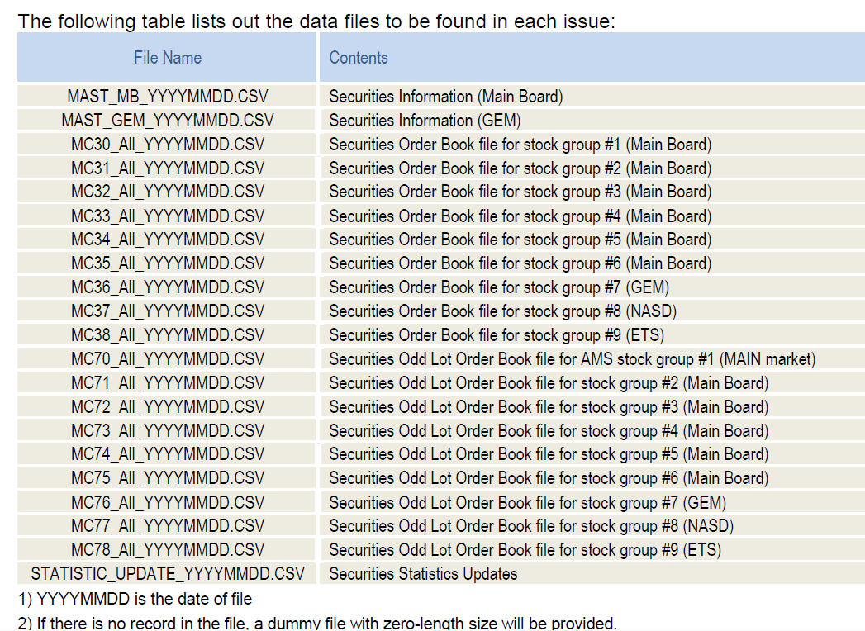
1. Raw Data – Historical Tick Data

Slide 23
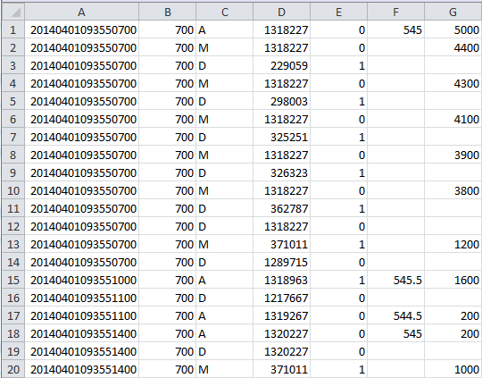
1. Raw Data – Historical Tick Data
Date/Time | Stock | Action | ID | Side | Price | Qty
Action (Order)
A: Add
M: Modify
D: Delete
Side
0 – Bid (Buy)
1 – Offer (Sell)
Sample File: 700.HK Raw Ticks

Slide 24
1. Raw Data – Historical Tick Data
HK Exchange Stats at 2021-Oct-27: Daily Trading Hours = 6 hours (21,600 seconds)
Total Ticks: 21,064,067 Per Seconds: 975.19
Code | Name | Count | Per Seconds
7500.HK | CSOP Hang Seng Index Daily (-2x) Inverse | 530,649 | 24.57
2828.HK | Hang Seng China Enterprises Index ETF HKD | 485,820 | 22.49
3690.HK | Meituan | 367,131 | 17
0700.HK | Tencent | 349,458 | 16.18
7200.HK | CSOP Hang Seng Index Daily (2x) Leveraged | 322,089 | 14.91
Total Trades: 1,654,095 Per Seconds: 76.58
Code | Name | Count | Per Seconds
3690.HK | Meituan | 54,328 | 2.52
0700.HK | Tencent | 46,529 | 2.15
9988.HK | Alibaba | 32,558 | 1.51
1024.HK | Kuaishou Technology | 23,303 | 1.08
6169.HK | China Yuhua Education | 22,145 | 1.03

Slide 25
2. Pre-processed Data – Order Book
Step 2: Pre-process the raw data
Historical tick data, which contains the records of every order transactions, is too low level and not easy to extract the useful information for predicting stock price movement
Pre-process the tick data to Stock Order Book
Size | Bid | Ask | Size
74,000 | 152 | 152.1 | 81,800
54,000 | 151.9 | 152.2 | 33,100
80,800 | 151.8 | 152.3 | 34,100

Slide 26
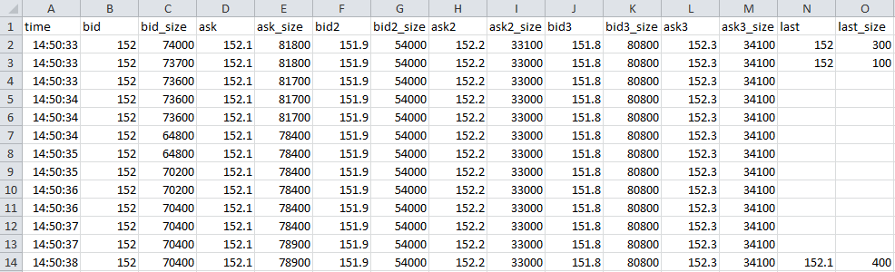
2. Pre-processed Data – Order Book
Sample File: 700.HK Order Book
Size | Bid | Ask | Size
74,000 | 152 | 152.1 | 81,800
54,000 | 151.9 | 152.2 | 33,100
80,800 | 151.8 | 152.3 | 34,100
Last Trade Price=152, Size=300

Slide 27
3. Feature Engineering
Step 3: Feature Engineering
Choose the “factors” to explains the outcome
In our case: choosing the factors to explain the stock price going up or down from the pre-processed data (i.e. stock order book)
The “factors” are called differently by different people
Statisticians call it explanatory variables or independent variables
Data Scientist call it features
Traders calls it trading signals
The outcome is also called the target or dependent variable

Slide 28
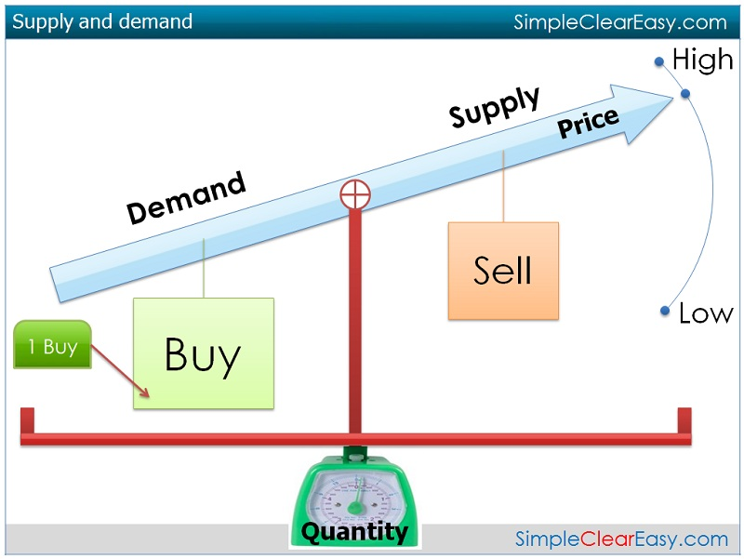
3. Data Feature
What factor can affect the stock price?
Order Book Imbalance
quantify supply vs demand.
ratio between the bid/ask size

Slide 29
3. Data Feature - Order Book Imbalance
Size | Bid | Ask | Size
100,000 | 152 | 152.1 | 20,000
400,000 | 151.9 | 152.1 | 550,000
200,000 | 151.8 | 152.3 | 80,000
Up / Down ?
Order Book Imbalance: ratio between bid/ask size
Bid Size > Ask size : price is more likely to go up
Vice versa, the price is more likely to go down
5min-Order Book-Imbalance = Avg (Log(Bid Size/ Ask Size))
The average log ratio between the bid and ask size over a rolling 5-min window.
Notes:
Ask why taking log – because the asymmetry of +ve and –ve ratio

Slide 30
3. Data Feature - Order Book Imbalance
Taking log to the bid/ask size ratio
Bid Size | Ask Size | Bid/Ask Size
1000 | 1000 | 1
2000 | 1000 | 2
5000 | 1000 | 5
10000 | 1000 | 10
100000 | 1000 | 100
Log(Bid/Ask Size)
0
0.30103
0.69897
1
2
Bid Size | Ask Size | Bid/Ask Size
1000 | 1000 | 1
1000 | 2000 | 0.5
1000 | 5000 | 0.2
1000 | 10000 | 0.1
1000 | 100000 | 0.01
Log Bid/Ask Size
0
-0.30103
-0.69897
-1
-2
Make the numbers symmetry
Positive: when Bid Size > Ask Size (demand > supply)
Negative: when Ask Size > Bid Size (supply > demand)
Notes:
Ask why taking log – because the asymmetry of +ve and –ve ratio

Slide 31
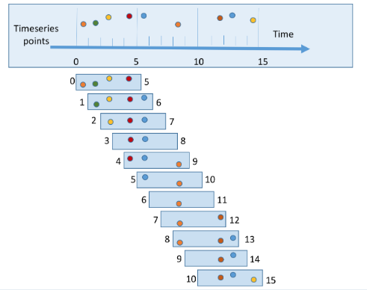
3. Data Feature - Order Book Imbalance
Average ratio over a rolling 5-min window
Smooth out the calculation (otherwise the values can change very rapidly)
Reduce the noise (the orders can be added or cancelled at any time) and better represent the underlying trend
The 5-min duration can be shorter or longer. Or based on numbers of ticks (for illiquid stocks)
Notes:
Ask why taking log – because the asymmetry of +ve and –ve ratio

Slide 32
3. Data Feature - Order Book Imbalance
Example
Calculate the top level OBI (order book imbalance) features to gauge the demand/supply.
Top Level (OBI-L1): 5-min-avg(Log(100,000 / 20,000))
= 1.609 ← Positive when Bid Size > Ask Size (demand > supply)
(Note: for illustration purpose, assume the results are the same in 5-min moving average)
Size | Bid | Ask | Size
100,000 | 152 | 152.1 | 20,000
400,000 | 151.9 | 152.2 | 550,000
200,000 | 151.8 | 152.3 | 80,000
Notes:
Ask why taking log – because the asymmetry of +ve and –ve ratio

Slide 33
3. Data Feature - Order Book Imbalance
Calculate the combined OBIs (L2 and L3) to include the order depths. More level implies a more aggregated demand/supply.
First 2 Level (OBI-L2): Log((100,000 + 400,000) / (20,000 + 550,000)) = Log(500,000 / 570,000)
= -0.13 ← Negative when Total Ask Size > Total Bid Size (supply > demand)
First 3 Level (OBI-L3): Log((100,000 + 400,000 + 200,000) / (20,000 + 550,000 + 80,000)) = Log(700,000 / 570,000)
= 0.07 ← Positive when Total Bid Size > Total Ask Size (demand > supply)
(Note: for illustration purpose, assume the results are the same in 5-min moving average)
Size | Bid | Ask | Size
100,000 | 152 | 152.1 | 20,000
400,000 | 151.9 | 152.2 | 550,000
200,000 | 151.8 | 152.3 | 80,000
Notes:
Ask why taking log – because the asymmetry of +ve and –ve ratio

Slide 34
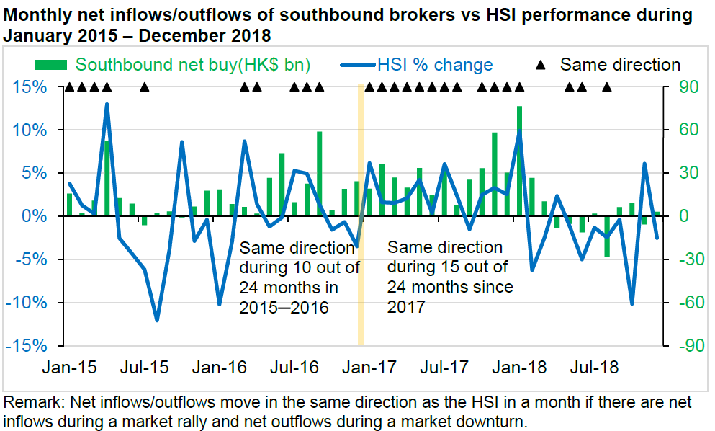
3. Data Feature - Money flow

Slide 35
3. Data Feature - Money flow
Money flow: the difference between buy and sell turnover (money)
$Buy > $Ask : price is more likely to go up
Vice versa, the price is more likely to go down
If more money are buying throughout the 5-min window than selling, the net money flow is positive.
5min-MoneyFlow = Σ(Buy size * price) - Σ(Sell size * price)
Options: The net difference between buy and sell turnover over a rolling 5-min window. The 5-min duration can also be customized to a shorter or longer duration.

Slide 36
3. Data Feature - Money flow
Size | Bid | Ask | Size
100,000 | 152 | 152.1 | 20,000
400,000 | 151.9 | 152.1 | 550,000
200,000 | 151.8 | 152.3 | 80,000
Time | Side | Size | Price | Turnover
10:00:08 | Buy | 500 | 152.1 | 76,050
10:01:21 | Buy | 300 | 152.1 | 45,630
10:03:05 | Sell | 400 | 152 | (60,800)
10:04:21 | Buy | 200 | 152.1 | 30,420
10:04:55 | Sell | 100 | 152 | (15,200)
 |  | Money Flow: |  | 76,100
10:05:13 | Sell | 100 | 152 | (15,200)
 |  | Money Flow: |  | (15,150)
10:06:33 | Buy | 300 | 152.1 | 45,630
 |  | Money Flow: |  | 50
Sum from 10:01:21
Sum from 10:03:05
Notes:
Ask why taking log – because the asymmetry of +ve and –ve ratio

Slide 37
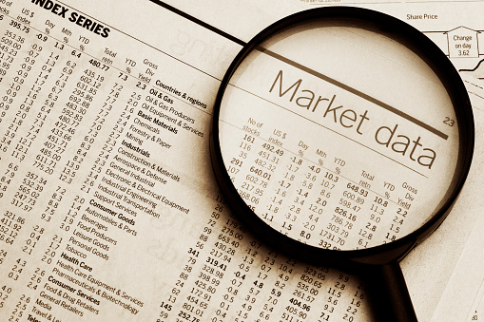
4. Labelled Dataset
Step 4: Generate labelled dataset from historical order book data for the Supervised Machine Learning
Labelled Dataset: Input Features -> Output Target
Input Features: order book features
Output Target: price move up/down
Use which period of the data and for how long?
For time related data, usually use the most recent data (need to consider re-training) or seasonal repeatable period (e.g. each Friday’s data, month-end, opening hours)
For shorter prediction horizon, usually look at shorter period (e.g. 1-day or 1-week)
This example is using the most recent 5 trading days (exclude special days) of historical market tick data

Slide 38
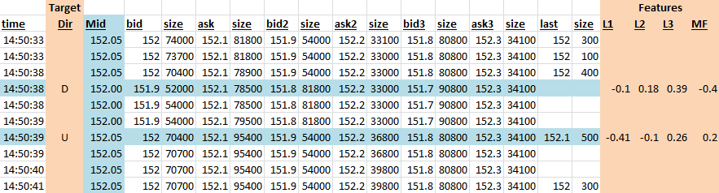
4. Labelled Dataset
Replay historical market tick data (last 1-week of Tencent)
When there’s a price up/down change (output target), generate the corresponding Order-Book-Imbalance and Money-Flow (input features)
Price is mid-price which is (bid + ask) / 2
The data scaled to [-1, 1] (Why Data Normalization is necessary for Machine Learning models)

Slide 39
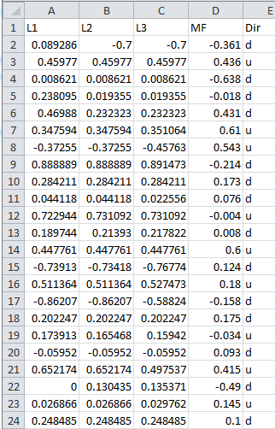
4. Labelled Dataset
Features
Target
Features
L1: First-1-Level OBI
L2: First-2-Level OBI
L3: First-3-Level OBI
MF: Money Flow
Target
Dir: Price u (up) or d (down)

Slide 40
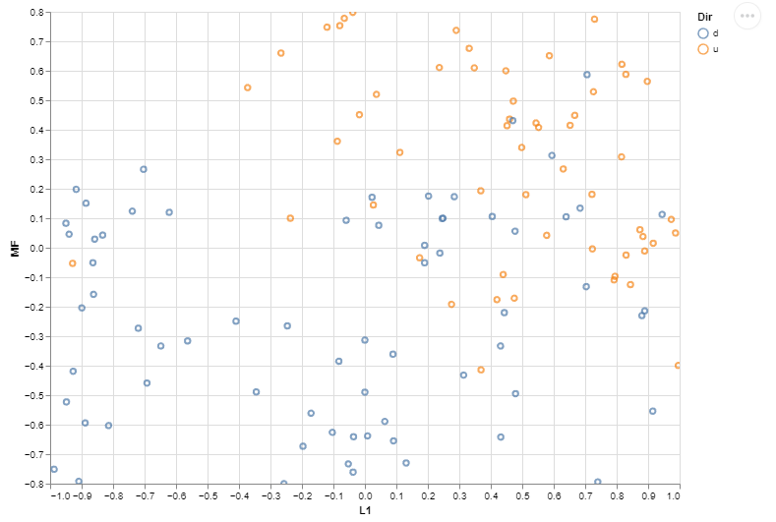
5. EDA (Exploratory Data Analysis)
Scatter Plot: L1 OBI (Order Book Imbalance) vs MF (Money Flow)
Brown dots: stock going up
Blue dots: stock going down
Money Flow
+ve : Demand > Supply
-ve: Demand < Supply
More Brown dots (up) when both Level-1 OBI and MF are positive and vice versa
Visually confirm our intuition when Demand > Supply (+ve OBI & MF), price tends to go up
Level-1 OBI

Slide 41
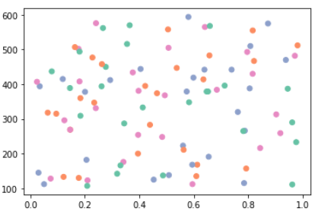
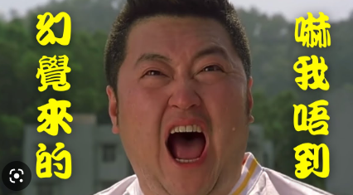
5. EDA (Exploratory Data Analysis)
Scatter Plot with random patterns
Feature A
It’s an illusion only
I’m not afraid
It means the features A and B are not useful in explaining the outcome and need to find other features
Feature B

Slide 42
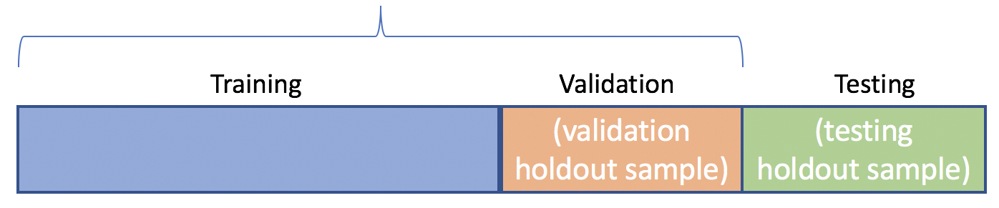
6. Machine Learning Dataset
Step 6.1: Split the labelled Dataset into Training, Validation and Testing
In-Sample
Training Set: the labelled data used to train the underlying model
Validation Set: set aside examples to tune the hyper-parameters
Test Set: the data set not seen by the model training and used only to assess the performance of a fully-trained model

Slide 43

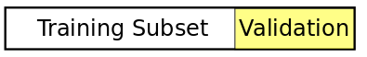
6. Machine Learning Dataset
Validation Set
Holdout Validation: reserve certain % of the training data as validation set. Recommend for large data sets.
Cross Validation: partition the data set to n-fold. Trains a model using the out-of-fold observations. Assesses model performance using in-fold data and calculates the average test error. Recommend for small data sets.

Slide 44

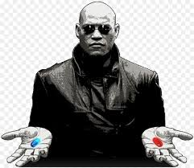
7. Machine Learning Algorithm – Decision Tree
Step 6.2: Choose a Machine Learning Algorithm that suitable for your dataset and objective

Slide 45
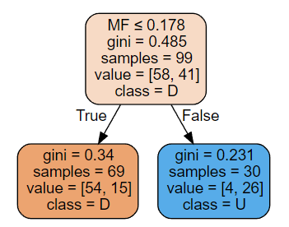
7. Machine Learning Algorithm – Decision Tree
Left branch = True
Right branch = False
gini quantifies the purity. The lower is better (as indicated by a darker color)
Values = [Down, Up]
Down class is orange box
Up class is blue box
Down: MF <= 0.178
Up: MF > 0.178
Train Accuracy: 0.81 Test Accuracy: 0.68
Code Example

Slide 46
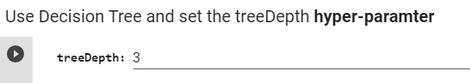
8. Hyper-parameter Tuning
Training Accuracy = Low, Testing Accuracy = Low
How to increase the training accuracy ?
Increase model capacity. For example increase the tree depth hyper-parameter in our decision tree example
This usually increase the training accuracy. If the testing accuracy is not increased accordingly, it’s called overfit

Slide 47
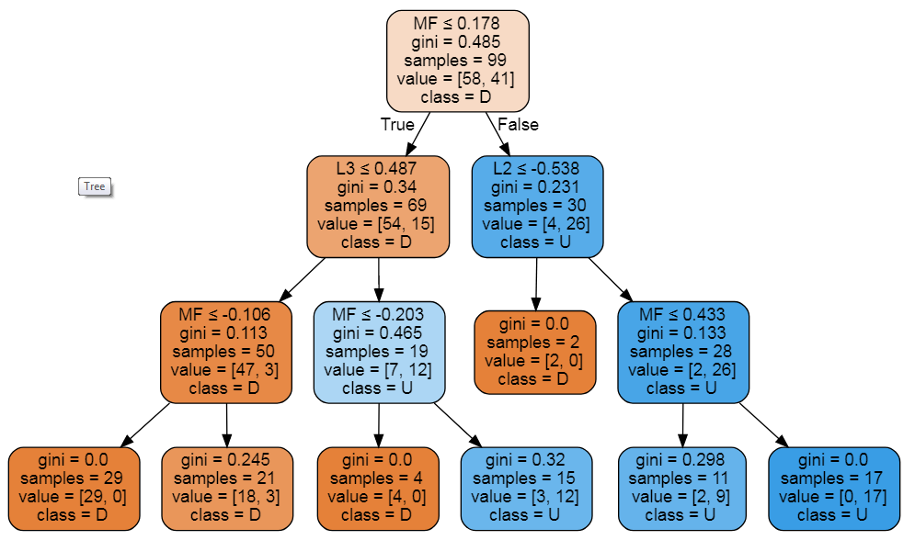
8. Hyper-parameter Tuning
Down: MF<=0.178 and L3<=0.478 and MF<=-0.106
Up: MF > 0.178 and L2 > -0.538 and MF > 0.433
Down: L3<=0.478 and MF<=-0.106
Up: L2 > -0.538 and MF > 0.433
Stay: Other than the above
Train Accuracy: 0.92 Test Accuracy: 0.68

Slide 48
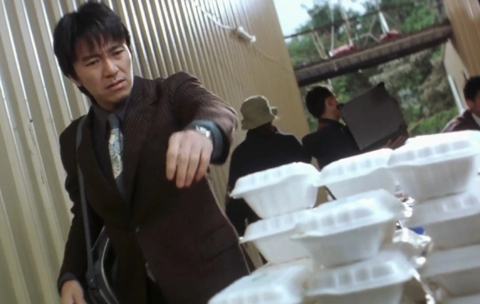
9. Model Selection
“No Free Lunch” theorem
No single machine learning algorithm is universally the best-performing algorithm for all problems

Slide 49

9. Model Selection
SVM (Support Vector Machine)
A classifier formally defined by a separating hyperplane.
The goal is to find the hyperplane that gives the largest minimum distance to the training examples. Therefore, the optimal separating hyperplane maximizes the margin of the training data (those data points in solid color that formed the maximum margin are the support vectors)
YouTube: SVM separate complex dataset

Slide 50

9. Model Selection
Nonlinear classification performed by applying kernel transformation
Transform to higher dimension space
(Notes: Statistical significance, Curse of Dimensionality)

Slide 51
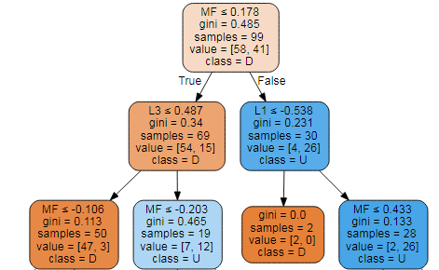
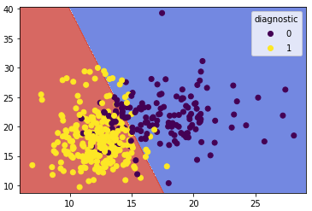
9. Model Selection
Decision Tree
Support Vector Machine
Train Accuracy: 0.92 Test Accuracy: 0.68
Train Accuracy: 0.88 Test Accuracy: 0.72
If Decision Tree and Support Vector Machine has similar training time, resource usage, and train/test accuracy, which model to choose?

Slide 52


9. Model Selection
(Compliance) Mr. Wong
“By the Support Vector Machine, the model classify the trading signals in the 1,000,141-dimension universe”
“In the 1,000,141 dimension universe, your trading strategy is approved.
But in our 4-dimension universe, it’s rejected because I don’t understand it.”
(Quant) Dr. Strength
Decision Tree is more interpretable

Slide 53
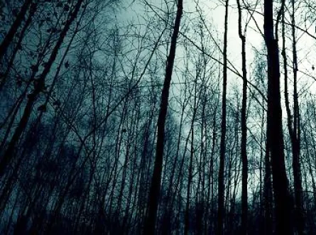
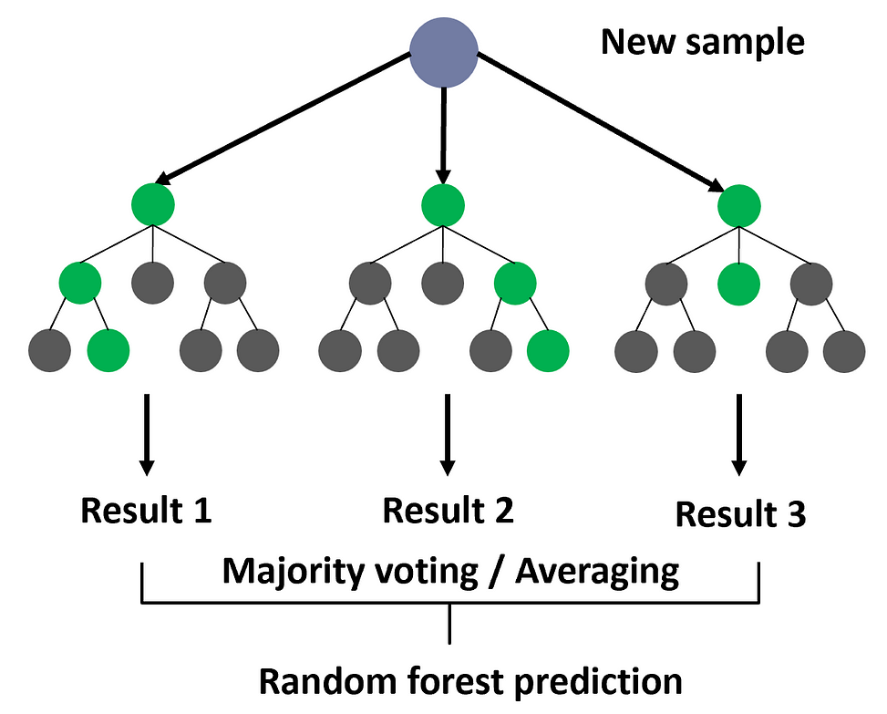
9. Model Selection
Other Machine Learning Classifier
Why use Decision Tree when you can use Random Forest
Don't give up the whole forest for a tree
別為一棵樹 放棄整個森林

Slide 54
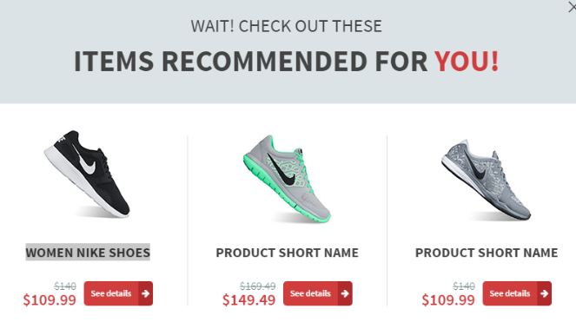

10. Performance - Evaluation
How much test accuracy is enough: 70%, 80%, 90%, 99% ??
It depends on the applications. Self driving cars require much higher accuracy than the product recommendation system.
Trading and investment predictions are generally not very high in accuracy.

Slide 55

10. Performance - Evaluation
Accuracy
Example: Credit Card Fraud detection system (fraud is an anomaly event that happen only 1% in the dataset). If the system is able to predict Fraud or “No Fraud” in 99% accuracy, do you think it is good enough?
NO, a dumb system that always predict “No Fraud” will achieve 99% accuracy. Need to look specifically at the accuracy of the “Fraud” cases (specificity).
Other metrics like Precision, Recall, F1 etc.

Slide 56


10. Performance - Evaluation
Training
Testing
Training vs Testing Accuracy
92% vs 68%
Testing accuracy is a lot lower and what’s that imply?
Is 68% good enough for trading?

Slide 57

10. Performance - Evaluation
Training Accuracy = High, Testing Accuracy = Low
How to increase the testing accuracy ?
It is something to do with the data
Add more data (rows) to learn enough variations and/or
Add/change the dataset features (columns). Features engineering the related data

Slide 58
11. Trained Model Usage
Size | Bid | Ask | Size
100,000 | 152 | 152.1 | 20,000
400,000 | 151.9 | 152.1 | 550,000
200,000 | 151.8 | 152.3 | 80,000
L1 | L2 | L3 | MF
0.15 | 0.03 | -0.32 | 0.453
Decision Tree Model
Down: L3 <=0.478 and MF<=-0.106
Up: L2 > -0.538 and MF > 0.433
Stay: Other than the above
Predicted Up

Slide 59

11. Trained Model Usage
Back to the original question :
Is 68% accuracy good enough for trading?
We can predict stock goes up/down in the next move with 68% accuracy

Slide 60
11. Trained Model Usage
The model predicts the stock price will go up for the next move, hence Buy it now @ $152.1 (Ask Price)
Size | Bid | Ask | Size
74,000 | 152 | 152.1 | 81,800
54,000 | 151.9 | 152.2 | 33,100
80,800 | 151.8 | 152.3 | 34,100
Size | Bid | Ask | Size
80,000 | 152.1 | 152.2 | 33,100
74,000 | 152 | 152.3 | 34,100
54,000 | 151.9 | 152.4 | 43,000
The stock price did go up as predicted, hence Sell it now @ $152.1 (Bid Price)
Lose all the profit from bid/ask spread, also pay the transaction costs

Slide 61

11. Trained Model Usage
So the model is useless and waste of time?
估短期升跌
咁係因為你悲觀 我睇到由治及興帶嚟嘅好處
It’s because you’re pessimistic, I can see the benefits

Slide 62
11. Trained Model Usage
The “short term price prediction” alone probably cannot be a profitable strategy by itself. However, it can be a sub-module to improve certain aspect of other strategies
Trading Strategies – HK Warrant Follow the Super Trader
Enter Trade when "super user" trade (when a single trade of notation greater than certain amount on a warrant and ask price move up (>= 1 tick) within 10ms to 5s
Exit Trade in these 3 modes
1: Profit mode: Sell if best bid + 2 ticks >= avg px
Improve Profit Mode by “Short Term Price Predictor”
wait a bit longer if the warrant underlying stock price is predicted to go up. Take profit sooner if price going predicted to go down

Slide 63

11. Trained Model Usage
Used by institutional Execution Algos for working a large order over the day (e.g. VWAP) to decide when to trade faster or slower
when the price is predicted to move favorably :
while the price is predicted to move away :
Slower
Faster
Slower
Faster
Behind
Ahead

Slide 64
12. Conclusions and Takeaways
Supervised ML (Machine Learning) is data driven and thus the data is the most important component. Spend most of the time (~80%) in sourcing, cleaning, pre-processing the data to useful features
GIGO (Garbage In Garbage Out). No matter how powerful is the ML model, if the data is not relevant, the results will not be good
The ML models are generic and they learn the knowledge from the data (e.g. use other TA features such as SMA, RSI for longer time horizon prediction). Hence it requires Domain Knowledge to formulate the right dataset and features in many applications
The ML models learn the relationship between the input features and the target. If there are well-known relationship (rules or formulas) between them, no need to use ML
If the input and target relationship doesn’t exist, the ML models won’t suggest what data features to use, worst still, it may “over fit” the data with a false relationship.

Slide 65

Unsupervised Learning - PCA
Principle Component Analysis: dimension reduction technique used to emphasize variation and bring out strong patterns in a dataset

Slide 66

Unsupervised Learning - PCA
Scatter Plot Order Book Imbalance (OBI)
Level-2 OBI
+ve OBI : Demand > Supply
-ve OBI : Demand < Supply
Level-1 OBI

Slide 67

Unsupervised Learning - PCA
Order Book Imbalance in different levels (L1, L2, L3) exhibit linearly patterns which are the candidates to apply PCA to reduce the dimensions
PCA usages
Features compression (multi-collinearity)
Reduce imbalance feature types
Cons
PCA features lose some explainability to the original features
Code Example

Slide 68

k-Means Clustering
k-means clustering: a type of unsupervised learning (unlabeled data).Find k groups in the data. The algorithm works iteratively to assign each data point to one of k groups based on the features that are provided. Data points are clustered based on feature similarity.
The centroids of the k clusters, which can be used to label new data
Labels for the training data (each data point is assigned to a single cluster)

Slide 69

k-Means Clustering
Example: Stock Pairs identification based on return and volatility

Slide 70

Deep Learning

Slide 71


Deep Learning – Neural Networks
Connectionism inspired by the biological neural networks that constitute animal brains

Slide 72

Deep Learning - Neural Networks
Think of Neurons as a Lego building blocks.
They can connect together to form many different shapes

Slide 73

Demo: Image Classification
Recognize car license plate from the photos
My classmate spent 6 months in his final year project back in 2000 which involve image processing (edge detection) and describe all the shapes
Speeding

Slide 74


Demo: Image Classification
Recognize hand-written zip code and route the mails accordingly
Code Example: Digits Classification

Slide 75

Deep Learning – CNN
Code Example: CIFAR-10 Image Classification

Slide 76


CNN Use Cases
認
If CNN can recognize a cat and a dog…..
Recognize a cat
Recognize a dog

Slide 77

CNN Use Cases – Trading Charts
People look at candlestick to trade They form some intuition on the market but cannot describe it
See if CNN auto-features discovery can detect the patterns
CNN Candlestick (by Jack Zhang): Slides Colab

Slide 78



Use Cases – Face Recognition
Limitation of Face Recognition – people wearing masks or with paintings
With painted faces, artists fight facial recognition tech
How to send Winnie-the-Pooh

Slide 79


CNN Use Cases – Face Recognition
化妝就係你落咗妝，我仲認得你，你落咗妝，我唔認得你，嗰啲叫做喬裝。
If you can still unlock FaceId, it’s called make-up, otherwise it’s a “fake-up”
上咗妝後 FaceId 仲認得叫做化妝，認唔到嘅叫做喬裝

Slide 80

Use Cases – People Recognition
Surveillance camera technology that can recognize you just from how you walk
Where is the labelled training dataset (Walking Style -> Name) coming from?
Shops: electronic payment + shops cameras
Security check: in airports, train stations when pass through the security gate
Name-registered phone: named-phone GPS + street cameras

Slide 81

Generative AI - Images
StyleGAN: Which face is real ??
AI Creates Fashion Model with Custom Outfits and Poses
Other GANs Applications

Slide 82




Generative AI - Images
Prompt: Teenager, female, seventeen years old, pop culture, modern clothing. Photorealistic, Natural lighting, Pastel
Image Credit: John Severinson

Slide 83

Generative AI - Videos
Deep Fake
Korea Virtual Girl
Live Demo
Infernal Affairs 2020 GANs version
Actors: Andy Lau & Tony Leung ??

Slide 84

Deep Learning – LSTM
Time Series data vs Image Data
Memory is important in this experiment
呢個實驗最重要係記性

Slide 85

Deep Learning – LSTM
Code Example: LSTM – Bitcoin Time Series

Slide 86
Appendix
~ Appendix Section ~

Slide 87

Introduction to AI - Second AI Boom
The second AI boom came in the 1980s.
Knowledge Representation (KR) and Expert system was booming and intended to describe knowledge that a machine could easily understand

Slide 88

Introduction to AI - Second AI Boom
Today the Internet is commonly used and we can obtain enormous amounts of open data from the Web. (Has Google search become Expert System?)
Cyc build an inference engine based on the database of this knowledge, called knowledge base.
IBM computer Watson wins Jeopardy clash

Slide 89

Machine Learning - Cloud
Image Analysis
Natural Language Processing

Slide 90

Machine Learning - Algorithm
New techniques in processing large amount of data in parallel (e.g. Map-Reduce)
Deep Learning solve some bottlenecks in training Neural Networks with many layers (so-call deep architecture)

Slide 91

Machine Learning – Investments
We all know private companies (like Google, Facebook, Amazon, Alibaba, Tencent invests a lot of money into AI. Government also involves heavily.
China moves to create AI innovation and development pilot zones. 20 AI pilot zones are targeted by 2023.
AI pilot zones are encouraged to “carry out AI based policy and social experiments” ranging from manufacturing to caring for elderly and disabled
Deqing County is cited as an example. The city is expected to focus on autonomous driving and smart farming
(Source: stateof.ai 2020 report)

Slide 92

Example – Linear Regression

Slide 93

Example – Linear Regression
Learning Regression (the model)
y = ax + b
Input Data -> Output
Parameter (a, b)
Loss/Objective function
Gradient Descent
Training (no. of steps)
Code Example

Slide 94


Objective function
A way to measuring the quality the model. This function, taking data and model parameters as arguments, can be evaluated to return a number. Any given problem contains some parameters which can be changed; our goal is to find values for these parameters which either maximize or minimize this number. (Similar terms: Cost function, Loss Function)

Slide 95

Gradient Descent
Gradient Descent: an optimization algorithm used to find the values of parameters (coefficients) of a function (f) that minimizes a cost function (cost).
Notes: Hyper-parameters are parameters whose values are set prior to the commencement of the learning process. By contrast, the values of other parameters are derived via training.

Slide 96

Learning Rate
Cost function between A and C is almost linear, and so gradient descent works well.
From point C, if we take a small learning rate at C, we will end up at D, which is reasonable enough since it doesn’t overshoot the point of minima.
A larger step size at C will get us to D ', which is not desirable, because it’s on the other side of the minima.
A large step size at D ' would get us to E, and if the learning rate is not reduced the algorithm tends to toggle between points on either side of the minima, leading to oscillations

Slide 97


9. Model Selection
Nonlinear classification performed by applying kernel transformation
Transform to another co-ordinate space

Slide 98

Performance - Confusion Matrix
False Positive: indicates a given condition exists, when it does not. Type I error where the test is checking a single condition, and wrongly gives an affirmative (positive) decision.
False Negative: that indicates that a condition does not hold, while in fact it does. Type II error occurring in a test where a single condition is checked for and the result of the test is erroneously that the condition is absent.

Slide 99

Performance – Type I & II Errors
Discussion
Production Support
Vs
Email Spam
How about Legal and Law?

Slide 100

Performance - ROC curve
Receiver Operating Characteristic (ROC) curve: plots the true positive rate against the false positive rate at various threshold settings. The true-positive rate is also known as sensitivity, recall or probability of detection in machine learning. The false-positive rate is also known as the fall-out or probability of false alarm and can be calculated as (1 − specificity). The ROC curve is thus the sensitivity as a function of fall-out.

Slide 101
Machine Learning Workflow
Data Preparation: determine the input for the machine learning
Dataset: Collect, Clean and Normalize (e.g. scale the data into standard measure) the data
EDA (Exploratory Data Analysis): Visualize (e.g. scatter plot) the data to understand the key properties
Feature Selections: apply dimension reduction techniques (e.g. Principle Component Analysis or Factor Analysis) to see if the data (i.e. input features) can be reduced while maintain the similar predictive power.
(Note: Data collection and feature selection usually required in-depth domain knowledge to pick up the right dataset for training)

Slide 102

Machine Learning Workflow
Training and Prediction
Choose Algorithm
Train (Learn) the model from data
Tune hyper-parameters
Evaluate the accuracy
Used the trained model for prediction

Slide 103


Machine Learning Workflow

Slide 104


Deep Learning - Example
Colorize Black & White Photos
Cloud hosted deep learning models on Algorithmia. The Colorful Image Colorization microservice is a computer vision algorithm trained on a million images from the Imagenet dataset.

Slide 105

Deep Learning - Neural Networks
Back propagation: calculate the error contribution of each neuron after a batch of data. Used by the gradient descent optimization algorithm to adjust the weight of neurons by calculating the gradient of the loss function.

Slide 106

Deep Learning – CNN
CNN (Convolutional Neural Network) image representation at different layers is similar to how the brain processes visual information
Human sees structure/region (not pixel)
Use convolution in place of general matrix multiplication in at least one of their layers to learn the feature in a region

Slide 107


Deep Learning – CNN
Dense layers learn global patterns in their input feature space (MNIST-digit patterns involving all pixels), whereas convolution layers learn local patterns: in the case of images, patterns found in small 2D windows of the inputs (3 × 3 window size).
Learn spatial hierarchies of patterns. A first convolution layer will learn small local patterns such as edges, a second convolution layer will learn larger patterns made of the features of the first layers, and so on. This allows convnets to efficiently learn increasingly complex and abstract visual concepts (visual world is fundamentally spatially hierarchical).

Slide 108

Deep Learning - Types
Long Short-Term Memory (LSTM) and Recurrent Neural Networks (RNN) are designed for sequence modeling.
They should be a good choice to model time series data

Slide 109

GANs (Generative Adversarial Networks)

Slide 110


GANs (Generative Adversarial Networks)

Slide 111




GANs (Generative Adversarial Networks)

